Slide 1
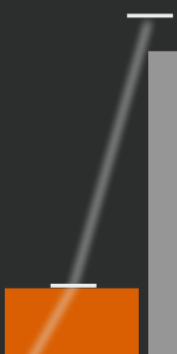
Drag the bars to move forward and backward in time
Small paths show the
direction to drag in
and the bar’s valid heights
Drag bar A above to try it!

Slide 2
When a bar doesn’t change height, follow
the wave by repeatedly dragging up and down
Drag bar B above to try it!

Slide 3
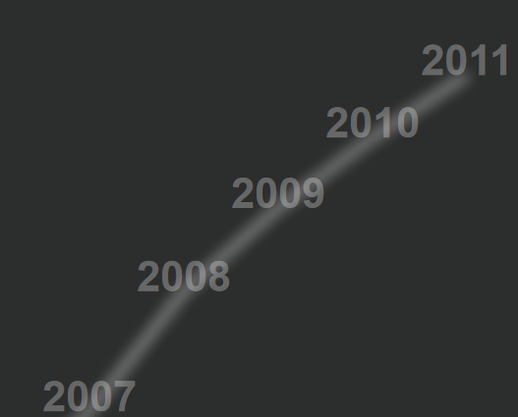
These paths show all heights of
a bar at each year
“Fast forward” in time by tapping any
year to go directly to that year.

Slide 4

Bars with zero height
are still draggable
using the grey placeholder

Slide 6
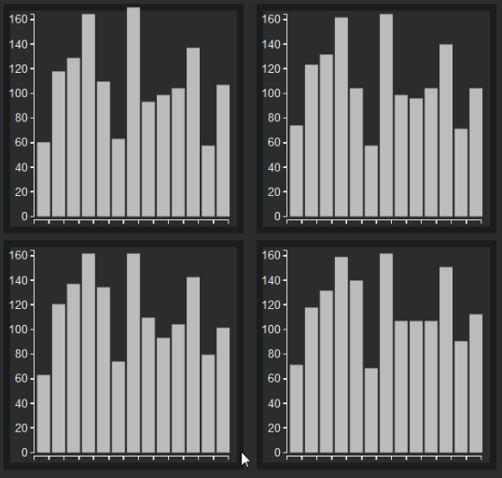
Views are arranged in time from left to right, then top to bottom
Time

Slide 7
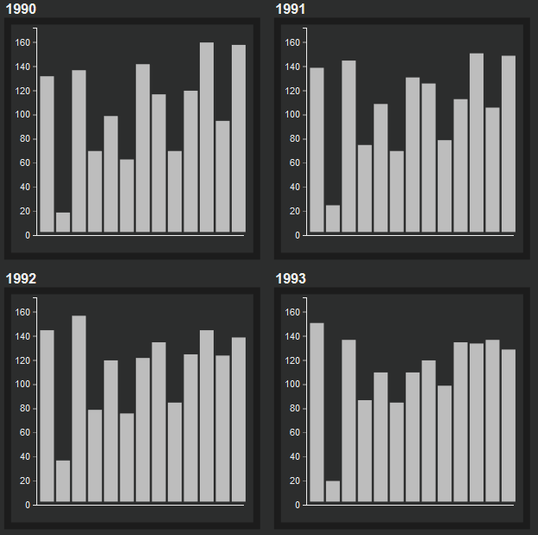
Views are arranged in time from left to right, then top to bottom
Time

